Slide 1
Designathons: Follow-up & Implementation
Eneyi Kpokiri, PhD
LSHTM & SESH

Slide 2
Rationale
There are several strong reasons to effectively plan for the series of events following the Designathon.
Provides a structured follow-through to final outcomes
Allows the organizers to give back to the group who contributed
Acknowledgment and empowerment
The ethos of designathon mandates that final outputs are widely shared

Slide 3
Following the designathon
Recognize exceptional ideas
Disseminate
Pilot
Revise
Research

Slide 4
Judge and recognize exceptional ideas
The Designathon judges will assess the proposals based on feasibility, desirability, impact, and teamwork
All teams will be acknowledged in the form of participation certificates and the exceptional ideas (e.g. the top three, top five) will be recognized
Award prizes- consistent with initial incentives published during promotion (credibility)
In addition to prizes, detailed judging feedback is provided to strengthen the idea in preparation for piloting/implementation

Slide 5
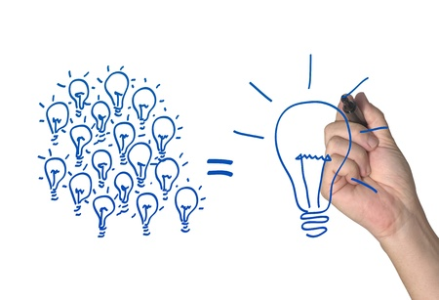
Disseminate
Effective dissemination is necessary to ensure that the output of the designathon reaches the group of focus who can then utilize or benefit from the innovation
Announce exceptional ideas
Event website
Open access platforms e.g. OSF, Wiki sites
On social media channels
Other relevant networks
Aim
Publicize the knowledge/intervention/solution produced

Slide 6
Pilot /Implement
After dissemination, the outcome is further refined for pilot or implementation in real settings
The output from a designathon can be pitched as an idea to interested stakeholders to implement new programmes or enhance existing ones
If teams are expected to pilot and implement their ideas, then there is the need to think carefully about training needed for this (e.g. if youth implementers)

Slide 7
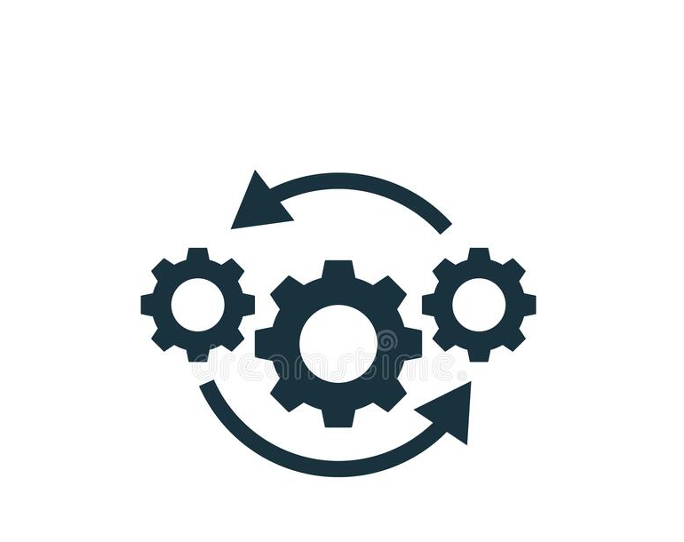
Revise
Feedback and data from the pilot can then be used to:
Iteratively improve out puts
Create version 2.0
Apply for grants/research funds

Slide 8
Further Research
Secure funds (consider crowdfunding)
Scale up ideas
Measure impact
Sustainability
Roll out in other settings

Slide 9
In summary
Designathon are not complete until results are shared and implemented using the appropriate channels
Effective implementation of outputs is largely dependent on:
Purpose of the designathon
Outcomes generated
Target audience/end users
Eneyi Kpokiri, PhD
eneyi.Kpokiri@lshtm.ac.uk

