Slide 1
Prepare for Designathon:
Things you need to know
Dr. Weiming Tang, PhD, MD, MS
University of North Carolina Project-China
Weiming_tang@med.unc.edu

Slide 2
Self-Check for planning
Ask your self: What’s for?
Before preparation
Phototyping an intervention (i.e., PrEP adherence/persistence) ?
01
Developing an APP (i.e., Gay Friendly Doctor)?
02
Developing a data analysis plan (data analyze hackathon)?
03
Is designation appropriate for your task or problem？
Who will be the participants of designathon?
When, where, and how long?
In-person or Hybrid
Cost

Slide 3
Organizing a mentoring and judging group
A group of mentors (between 5-8) is needed to provide mentoring, technical support, and advises to the designathon teams
The mentors should engage in key stakeholders with multidiscipline experience/ skill, i.e., include individuals with expertise in public health, civil society, communications, design
Discuss the aim, judging criteria, time-line with the mentoring team before the designathon during the mentor meeting

Slide 4
Participants recruitment and grouping
The participants should include key stakeholders that closely work with the end-users of the designathon
Widely disseminate a call for participation in order to identify participants
Using multiple platforms and networks will increase heterogeneity
Eight or more groups are expected, with a team with 3-5 participants
Inviting CBO leaders to nominate participants
Inviting crowdsourcing finalists to contribute

Slide 5
Participants recruitment and grouping
Group the participants into eight or more groups, and each team include 3-5 participants
Grouping the participants base on their expertise, and ensure each team will have a team leader, an end-user, a participant with designing/IT stills (depends on the needs), and a healthcare provider
The grouping can be random or base on the willingness of the participants
Suggest the teams to have independent group meetings at least one month before the designathon
The team can start to prepare their designing before hand

Slide 6
Handbook preparation
A handbook is needed to clarify the rules, judging criteria and expectations
Clarify the aim, prize structure, and contact person
The handbook will include the detailed time and arrangement of the designathon
The handbook will describe all the logistics of the designathon, including time, location, hotel, ticket booking, insurance, meal, etc.
Include a pre-post designathon survey towards the participants, and mention what data will need to be collected from the participants

Slide 7
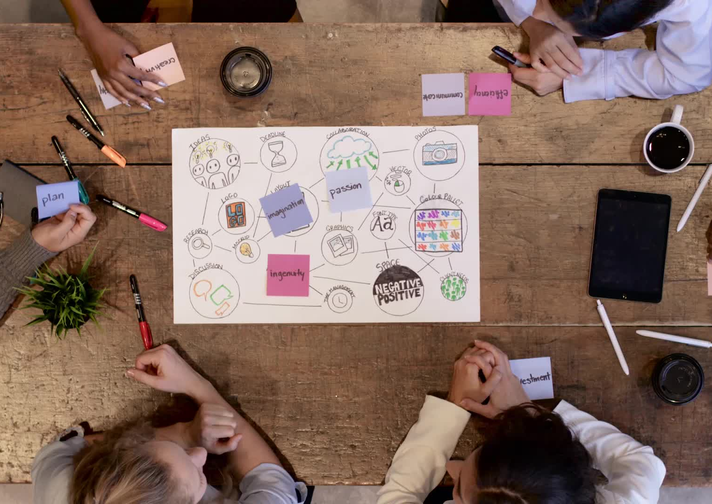
Tips
1, well prepared, give enough time to the participants to co-create
2, the 48 hours/72 hours event is just the last chance for the team to co-create
3, the plans of each team can be combined/integrated

